Slide 1
Programming Languages Used in Mobile Application Development

Slide 2
Native Mobile Application Development Languages
• Swift (iOS):
Swift is Apple's powerful and intuitive programming language for macOS, iOS, watchOS, and tvOS. It is known for being easy to learn, safe, and fast. Swift incorporates modern language features like type inference, optionals, and closures.
• Objective-C (iOS):
Objective-C is an older language for iOS development. Though it has largely been replaced by Swift, it remains relevant for maintaining legacy iOS applications

Slide 3
Native Mobile Application Development Languages Contd.
• Java (Android):
Java has been the primary language for Android development for many years. It is robust, object-oriented, and has a large community of developers. It is still commonly used in Android development, though Kotlin is gradually becoming the preferred language.
• Kotlin (Android):
Kotlin is a modern, statically typed programming language that fully interoperates with Java. Google officially adopted Kotlin as the preferred language for Android development due to its concise syntax, safety features, and improved developer productivity

Slide 4
Cross-Platform Mobile Application Development Languages
• JavaScript (React Native):
JavaScript is widely used in cross-platform frameworks like React Native. Developers can write React components and then compile them to native iOS and Android apps. JavaScript's popularity and flexibility make it a go-to language for cross-platform apps.
• Dart (Flutter):
Dart is a client-optimized programming language developed by Google. It is used with the Flutter framework for building fast, expressive mobile UIs. Dart is optimized for performance and can compile to native machine code.

Slide 5
Cross-Platform Mobile Application Development Languages Contd
C# (Xamarin): C# is used with the Xamarin framework to build cross-platform apps that run on iOS, Android, and Windows. It is a versatile language with strong typing, object-oriented features, and robust libraries.

Slide 6
Mobile User Interface (UI) Design
Mobile User Interface (UI) Design refers to the process of creating the visual and interactive aspects of applications specifically for mobile devices It’s a key component in mobile app development, aimed at optimizing the user's interaction experience by making the app intuitive, efficient, and enjoyable to use.
It focuses on creating interactive and visually appealing interfaces for mobile applications, ensuring an optimal experience for users on smartphones and tablets.
The primary objective is to make the interface user-friendly, accessible, and visually appealing while also being responsive to different screen sizes and orientations.

Slide 7
Key Design Considerations in Mobile UI Design
When designing the UI of mobile applications, several key considerations are essential to create an effective, accessible, and aesthetically pleasing interface.
User-Centric Approach
Mobile UI design prioritizes the needs and preferences of the user.
• Target Audience: Designers must understand who will be using the app, their needs, and their preferences.
For example, a business productivity app might prioritize efficiency and clarity, while a social media app might focus on engagement and aesthetics.
• User Goals: Identify what users aim to accomplish and tailor the UI to facilitate these goals. This approach aligns with the principles of User-Centered Design (UCD), emphasizing user satisfaction.

Slide 8
Key Design Considerations in Mobile UI Design Contd
Screen Size and Device Orientation
Responsive Design: Mobile screens vary in size, so UI elements should adapt to different screen dimensions without compromising functionality or readability. Responsive layouts help apps adjust smoothly to various devices, including tablets and foldable screens.
Orientation: Designing for both portrait and landscape orientations ensures that the app remains functional and visually appealing regardless of how users hold their device.

Slide 9
Key Design Considerations in Mobile UI Design Contd
Touch-Based Interaction and Accessibility
Touch Targets: Design elements such as buttons should be large enough to accommodate touch inputs accurately. Small buttons can frustrate users, especially those with larger fingers.
Gestures: Incorporate familiar gestures, like swiping and pinching, to make navigation intuitive. Avoid overwhelming users with complex gestures, as simplicity promotes ease of use.
Accessibility: Ensure that the app is accessible to users with disabilities by implementing accessibility features such as screen reader compatibility, high-contrast colors, and adjustable text sizes. Following accessibility standards, such as WCAG, makes the app usable for a broader audience.

Slide 10
Key Design Considerations in Mobile UI Design Contd
Consistency and Visual Hierarchy
Consistent Design Language: There is the need to use a consistent color palette, typography, and iconography across the app to create a cohesive look. This helps users feel comfortable and confident navigating the interface.
Visual Hierarchy: Arrange UI elements to prioritize essential information and actions. Use size, color, and position to create a natural flow that guides users' attention to the most critical parts of the screen.

Slide 11
Simplicity and Minimalism
Mobile screens have limited space, so the UI design is typically minimalistic, emphasizing essential content and functionality
Reduce Clutter: Simplify the interface by focusing only on necessary features and removing any elements that do not directly contribute to the app's purpose. This reduces cognitive load and makes navigation straightforward.
Whitespace: Use whitespace strategically to improve readability and focus attention on key elements.

Slide 12
Feedback and Interaction Design
Provide Feedback: Users should receive instant feedback on their actions. For instance, when a button is tapped, changing its color or displaying a loading icon informs the user that the app has registered their action.
Error Prevention and Recovery: Design with potential user errors in mind and provide ways to correct them. For instance, give users the option to undo actions or provide clear error messages when needed.

Slide 13
Utilize Mobile Capabilities
Device-Specific Features: Take advantage of features like location services, cameras, and biometric sensors. For instance, location-based suggestions in a travel app can improve the user experience.
Offline Mode: Consider implementing an offline mode to enhance usability in areas with limited internet connectivity.

Slide 14
Key Principles of Mobile UI Design
Clarity: Ensure that users can understand and use the interface easily.
Consistency: Maintain uniformity in design elements for a cohesive experience.
Efficiency: Make key actions easy to perform with minimal steps.
Aesthetics: Design with visual appeal in mind, balancing functionality and aesthetics.
Scalability: Plan for future growth, allowing the app to evolve and adapt to new features or devices.

Slide 15
Importance of Mobile UI Design
User Satisfaction: A well-designed UI enhances user satisfaction, promoting positive interactions and increasing the likelihood of repeated use.
Brand Identity: UI design communicates a brand’s visual identity and contributes to brand consistency across digital platforms.
User Retention: Effective UI design reduces friction in navigation, which can lead to better user retention and positive app reviews.

Slide 16
Best Practices in Mobile UI Design
Test with Real Users: Conduct usability testing to gather feedback and refine the design based on real user interactions.
Prioritize Load Speed: Ensure the UI is lightweight to minimize load times, enhancing the user experience.
Iterate Continuously: UI design is an iterative process. Use analytics and feedback to make continuous improvements to meet user needs.
References:
https://material.io/design/
Tidwell, J. (2019). Designing Interfaces: Patterns for Effective Interaction Design (3rd ed.). O’Reilly Media.

Slide 17
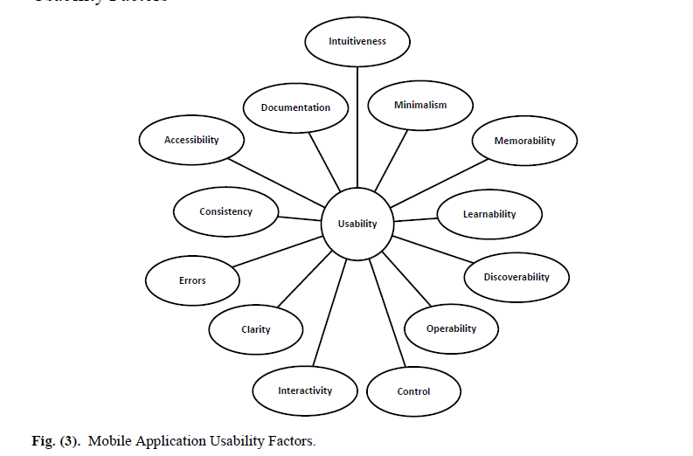
Usability
Refers to the ease with which users can interact with a product, system, or interface to achieve their goals effectively and efficiently. In mobile application development, usability is a key component of user experience (UX) design. It encompasses various aspects such as intuitiveness, accessibility, performance, and user satisfaction.

Slide 18
Benefits of Usability
Improved User Satisfaction
A highly usable app leads to greater user satisfaction, which in turn increases retention and user engagement. Satisfied users are more likely to return to the app and recommend it to others.
Increased Productivity
Usable apps enable users to achieve their goals quickly and efficiently, increasing their productivity. This is especially important for apps used in a professional or task-oriented context.
Reduced Support Costs
When users can easily figure out how to use an app on their own, there is less need for customer support or help resources, which can save companies time and money.
Higher Conversion Rates
For commercial apps, usability directly impacts conversion rates. An easy-to-use app makes it more likely that users will complete purchases, sign up for services, or engage with monetized features

Slide 19
Mobile App Development Lifecycle
The Mobile App Development Life Cycle (MADLC) outlines the stages required to develop, test, deploy, and maintain a mobile application. Like traditional software development, the MADLC involves a structured process to create a functional, user-centered application that meets both business goals and user needs.

Slide 20
Steps of Mobile App Development Lifecycle
Planning and Requirement Analysis
Define the app’s purpose, objectives, target audience, and functionality requirements.
Activities at this stage include:
Conduct market research to understand user needs and competitor offerings.
Identify technical and design requirements based on the app’s target platform (iOS, Android, etc.).
Create a project plan, outlining timelines, budget, resources, and potential risks.

Slide 21
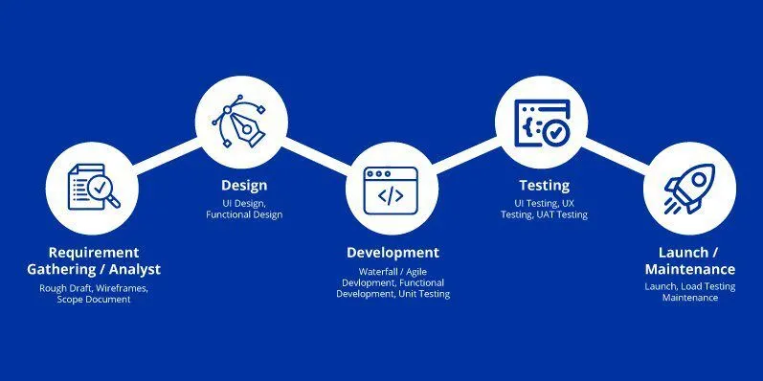
Mobile App Development Lifecycle:

Slide 22
UI/UX Design
The purpose of this phase is to create a visually appealing and intuitive user interface that enhances user experience.
Activities:
Architecture and Workflow:
The first phase in the mobile app design process is to decide what data or information your app will present to users, what data it will gather, how users will interact with the app.
Create Prototypes/ Wireframes:
A wireframe serves as a blueprint for the app, showing the placement of key elements like buttons, text, images, and navigation paths. This helps designers, developers, and stakeholders visualize the app's functionality and flow early in the development process. Develop wireframes to visualize the app’s structure and flow.
Conduct user testing on prototypes to gather feedback and make necessary adjustments.
Outcome: Finalized UI/UX design prototypes and mockups ready for development, ensuring a user-friendly experience.
Notes:
Wireframing in mobile app development is the process of creating a simplified, skeletal outline of an app's design to define the structure and layout of each screen before moving into detailed design and coding

Slide 23
App Development
This purpose of this phase it to begin the actual coding and implementation of the app’s front-end (user interface) and back-end (server-side components).
Activities in this phase include:
Back-End Development: Set up databases, server-side logic, and APIs for data processing and app functionality.
Front-End Development: Build the app’s interface, integrating UI designs and coding the app’s features.
Integrate APIs for third-party services if necessary, such as payment gateways, social media sharing, or geolocation.
Outcome: A fully coded app, though untested, that integrates both front-end and back-end functionality.

Slide 24
Testing and Quality Assurance
The purpose of this phase it to identify and fix any issues related to functionality, usability, performance, and security.
Activities Include:
Conduct functional testing to ensure each feature operates as intended.
Perform usability testing to confirm the app meets user experience expectations.
Run performance tests to check load times, responsiveness, and overall app speed.
Conduct security testing to safeguard user data and prevent vulnerabilities.
Perform compatibility testing on multiple devices and operating systems.
Outcome: A stable and reliable app, free from critical bugs and performance issues, ready for deployment.

Slide 25
Deployment
The Purpose is to release the app to the app stores (e.g., Google Play Store, Apple App Store) and make it available to users.
Activities Include:
App Store Submission: Prepare the app according to app store guidelines, which may include providing app descriptions, screenshots, and other details.
Set up analytics tools for tracking app usage, engagement, and user feedback.
Initiate a soft launch or limited release if needed, allowing a small audience to test the app before a full release.
Outcome: The app is live and available for download on app stores, with analytics in place to track performance.

Slide 26
Maintenance and Updates
The purpose of this phase is to ensure the app remains functional, secure, and relevant by addressing bugs, adding new features, and responding to user feedback.
Activities Include:
Regularly monitor app performance using analytics tools.
Provide bug fixes and patch updates to address security vulnerabilities or performance issues.
Release feature updates based on user feedback or changing business needs.
Conduct continuous testing after each update to ensure stability.
Outcome: A continually improved app that remains relevant and competitive in the market, fostering user satisfaction and retention

Slide 27
Considerations in Mobile App Development
Platform Selection: Choose between native, hybrid, or cross-platform development based on budget, target audience, and app complexity.
App Performance Optimization: Focus on minimizing load times, battery usage, and data consumption.
Security Measures: Safeguard user data through encryption, secure APIs, and regular security testing.
Scalability: Design the app to support growth, allowing for new features and a larger user base over time.

Slide 28
Mobile App Distribution
Mobile app distribution is an essential part of the mobile App application development process. Once an app is developed through the application development lifecycle, it needs to be distributed to the intended audience.
iOS
iOS apps are distributed through the Apple App Store, which is the only official app distribution platform for iOS devices.
Developers must follow Apple’s guidelines and submit their app for review before it can be made available on the App Store.
The review process typically takes around 1-2 weeks, during which the app is tested for compliance with Apple’s guidelines and quality standards.
Once the app is approved, it can be downloaded by users worldwide.

Slide 29
Android
Android apps can be distributed through various app distribution platforms, including the Google Play Store, Amazon Appstore, and third-party app stores.
Developers must comply with Google’s guidelines and submit their app for review before it can be made available on the Google Play Store.
The review process typically takes a few hours to a few days, depending on the complexity of the app and the number of submissions.
Unlike iOS, Android allows the installation of apps from third-party app stores, making it easier for developers to reach a wider audience.

Slide 30
UWP (Universal Windows Platform)
UWP apps are distributed through the Microsoft Store, which is the official app distribution platform for Windows devices.
Developers must comply with Microsoft’s guidelines and submit their app for review before it can be made available on the Microsoft Store.
The review process typically takes a few days to a week, during which the app is tested for compliance with Microsoft’s guidelines and quality standards.
Once the app is approved, it can be downloaded by users worldwide.

Slide 31
Role of Mobile App API
An application programming interface (API) is a software intermediary that allows multiple applications to communicate with one another.
It allows apps to communicate with one another and share information. APIs can also be used to expand the functionality of a mobile app. APIs are substantially important in mobile app development. It would be extremely difficult for mobile apps to use a massive amount of data in a usable mobile framework without the assistance of quality APIs.
APIs enable the integration for both developers and users. Integration simplifies developer tasks, and integration equals better services and more information for users. APIs can be purchased and custom-built to meet an organization’s specific requirements and needs. APIs are critical to the functionality and efficiency of mobile apps.
Notes:
They assist developers in creating immersive digital experiences for their end-users, as well as making aspects of the development process smoother and more efficient

